Slide 1

ECE 554 Lightning Talk
Team 4

Slide 2

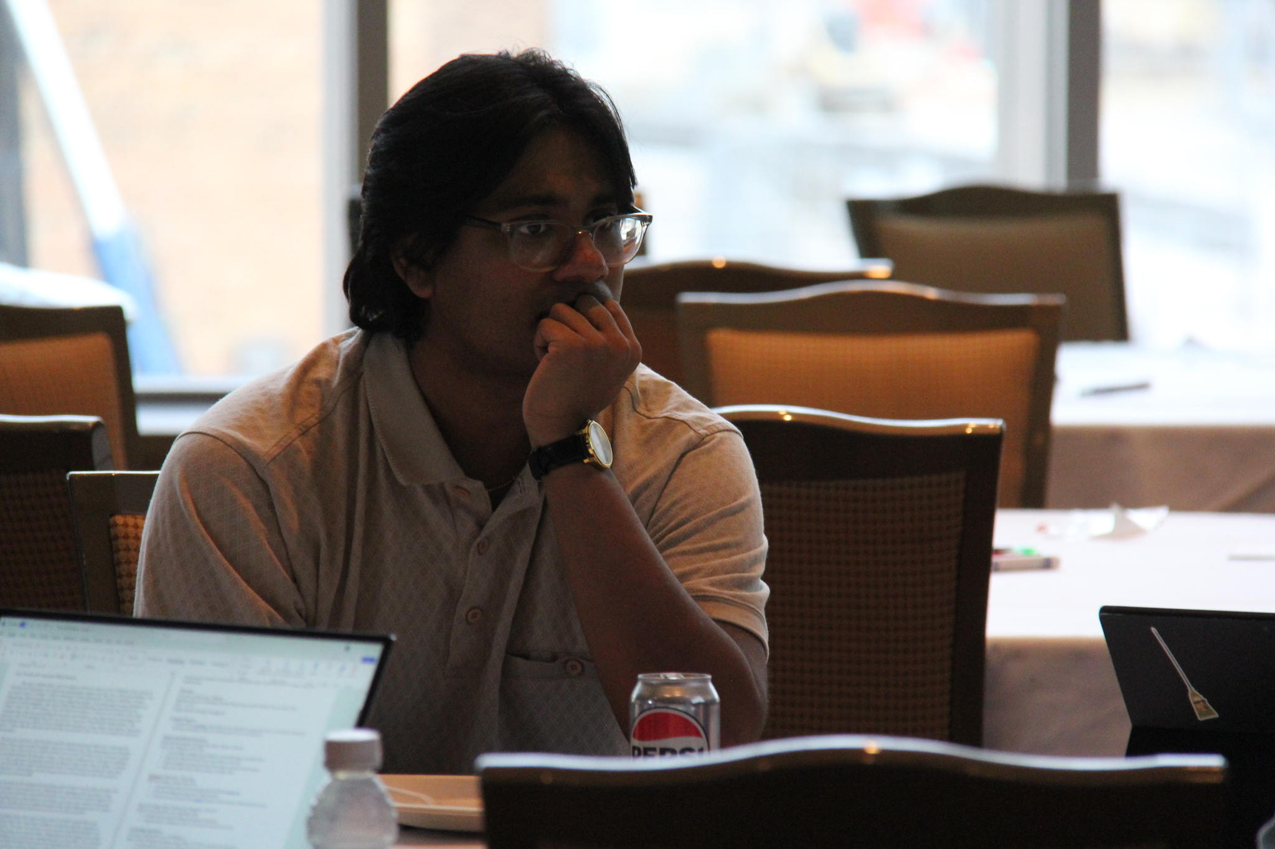
Team Introduction
Tyler Jordan - Computer Engineering,
Computer Science,
Applied Mathematics
Shantanu Chaudhuri - Computer Engineering,
Computer Science

Slide 3
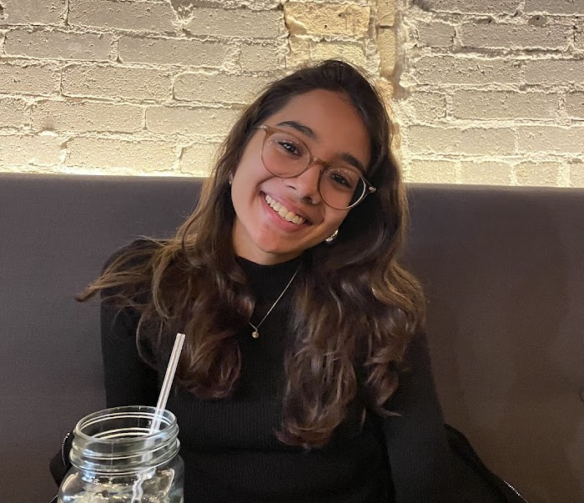

Team Introduction
Paridhi Gupta - Computer Engineering,
Computer Science,
Data Science
Diego Navarro - Computer Engineering

Slide 4
Use Case Definition
Overview
Our project is a motion-based dance game inspired by Just Dance, implemented on the DE1-SOC platform. The system captures a user's dance movements in real time, processes them using edge detection, and compares them to a reference video to evaluate performance accuracy.
Actors
Player – Performs dance moves.
System (DE1-SOC) – Captures and processes video input, evaluates performance, and provides feedback.
Preconditions
Reference video is stored on USB/SD card and is accessible.
Camera is connected and functional for live video capture.
User is positioned properly within the camera frame.

Slide 5
Use Case Definition
Flow of Events
User selects a dance routine.
System begins streaming the reference video and song audio.
Camera captures live movements of the user.
Image processing applies edge detection and normalization to both reference and live video.
Similarity analysis (Mean Squared Error - MSE) compares user movements to reference.
Score is calculated based on movement accuracy.
Feedback is displayed via screen and LED indicators.
Postconditions
User receives a performance score based on movement accuracy.
System may store results for further analysis or replay.

Slide 6
Motivation
We took inspiration from Ubisoft’s hit video game series: Just Dance!
An implementation on the DE1-SOC requires accurate timing alignment, utilizes several peripherals and data processing streams, and has an interactive demo element - which aligns well for the project
Paridhi is a part of a dance class and is incredibly passionate about the intersection between dance and technology
It was either this or a vacuum (roomba)

Slide 7
Approach
Reference Video Storage & Live Capture
Store the reference video in an SD card or USB for efficient retrieval.
Capture live video feed in real-time using a camera.
Image Processing Pipeline
Preprocessing: Resize images and convert them to grayscale.
Normalization: Adjust pixel values for consistent comparison.
Edge Detection: Extract key image features using:
Gaussian Blur: Prioritizes pixels at the image center.
Image Gradient Calculation: Uses Sobel filters for edge sharpening.
Double Thresholding: Distinguishes strong, weak, and non-edges.
Edge Tracking by Hysteresis: Refines detected edges for accuracy.

Slide 8
Approach Cont.
Image Comparison Algorithm
Compute Mean Squared Error (MSE) to quantify differences.
Heavy computational workload requires an accelerator for real-time processing.
System Interfacing & Output
Output video to a screen via VGA.
Display the matching score on LEDs using the FPGA.

Slide 9
Anticipated Challenges
Processing Video Data from USB
Efficiently handling large video files from USB storage.
Exploring a suitable compression approach to balance speed and quality.
Timing Alignment Between Multiple Data Streams
Synchronizing reference video (USB), song audio (micro SD), and camera input (GPIO) to ensure real-time feedback.
Managing potential latency issues between different data sources.
Developing Accurate Body Movement Tracking
Designing robust edge detection algorithms that effectively track dance movements.
Ensuring real-time processing of movement data without excessive delays.
These challenges require optimized hardware acceleration, efficient data handling, and precise synchronization techniques to achieve smooth gameplay and accurate scoring.
Notes:
Shantanu

Slide 10
Risk Management
Handling Video Parsing Issues
If we are unable to properly decode video data from USB, our contingency plan is to run the reference video on separate hardware to ensure smooth playback.
Store only important comparison data on the fpga
Addressing Body Movement Tracking Challenges
If edge detection does not effectively track body movements, we will pivot to glove tracking, focusing only on hand movements.
This adjustment simplifies the comparison logic while still maintaining an interactive gameplay experience.
These contingency plans ensure that the project remains functional and delivers a compelling demo, even if some technical hurdles arise.

Slide 11
Milestones and Evaluation
Milestone 1 (March, 4th): Architectural Review
Algorithm selection -> Specific type of accelerator, ->ISA
Peripheral selection -> h.264 decoder, mp3 decoder
Milestone 2 (March, 11th): Microarchitectural Review
High-level processor architecture, modular accelerator diagram,
Milestone 3 (March, 20th): Basic Building Blocks Implementation
Processor core pipelines, connections between modules, inputs and outputs..
Compiler Basics

Slide 12
Milestones and Evaluation Cont.
Milestone 4 (April, 3rd): Processor/Accelerator implementation & basic software support
Compiler Functional, and compile basic game loop.
Milestone 5 (April, 15th): Complete System Implementation
Minimum: Motion tracking, game loop. Optimal: Video and audio integration.

Slide 13
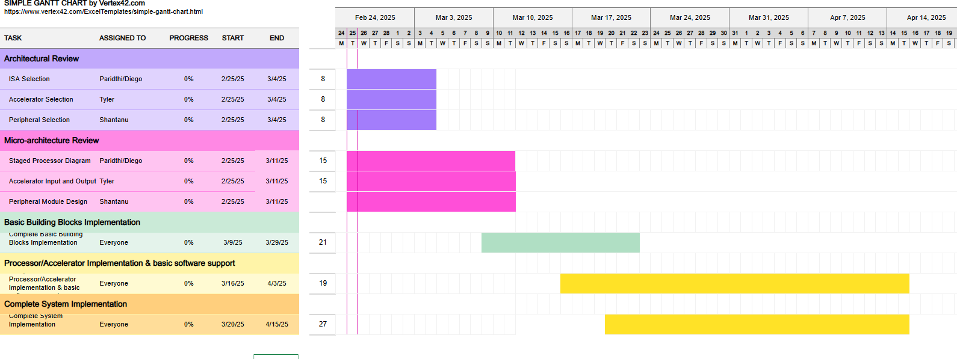
Gantt Chart

Slide 14
Team Responsibilities
Tyler: Accelerator
Shantanu: Peripherals
Paridhi: Processor
Diego: Software

Slide 15
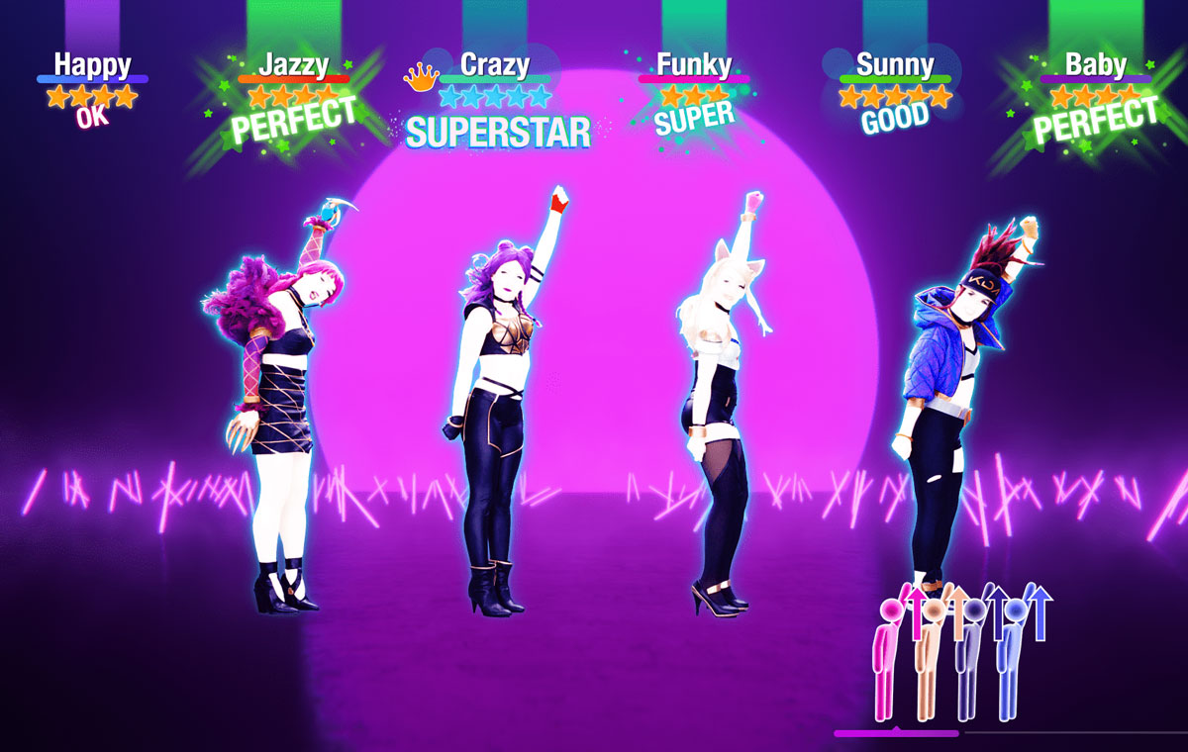
Questions?

